Slide 1
Self Introduction

Slide 2
Hello!
My name is
Rukeme
You can call me
Mr. Rukeme

Slide 3

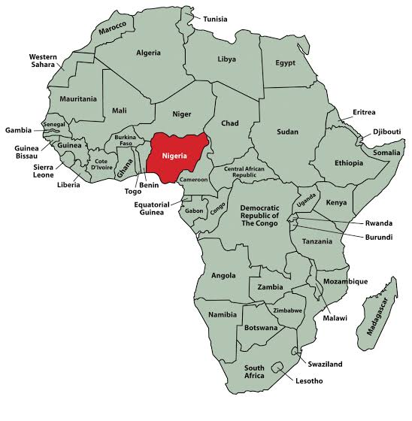
I’m from Nigeria.

Slide 4
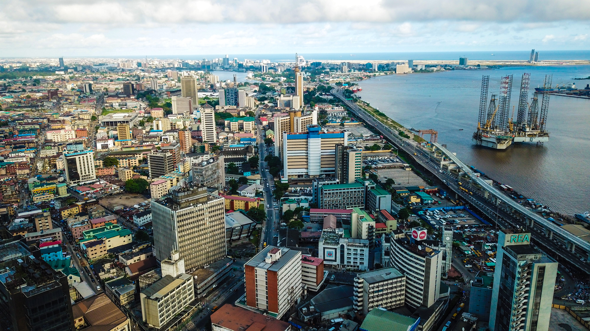
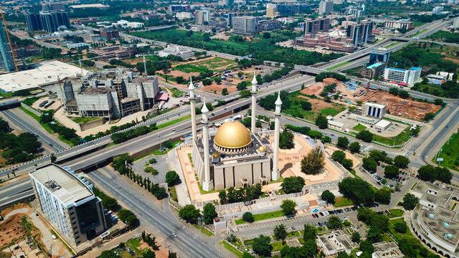
Nigeria
Abuja
Lagos

Slide 5
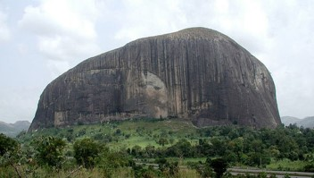
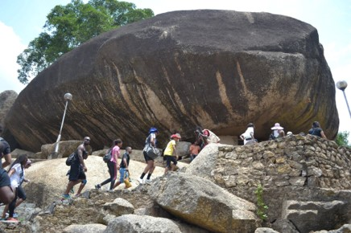
Nigeria
Zuma rock
Olumo rock
You can go rock climbing in Nigeria.

Slide 6

My Birthday is January 17th.

Slide 7
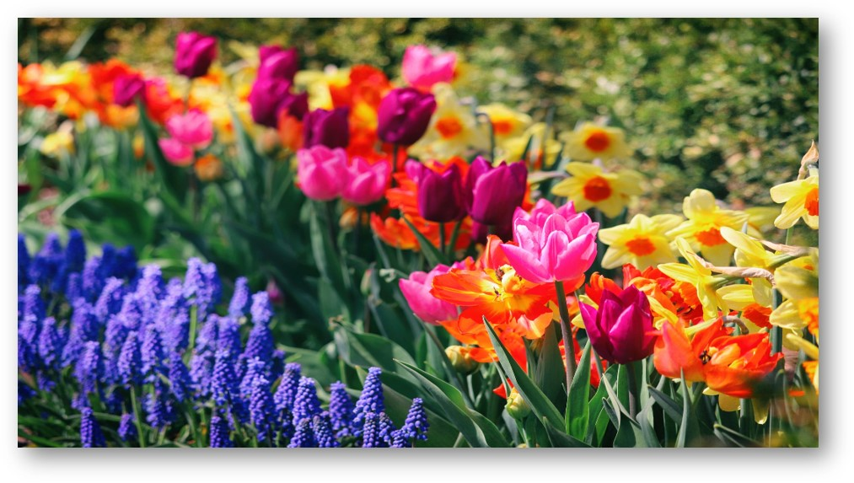
My favorite season is spring.
I like flowers.

Slide 8




I like anime.

Slide 9
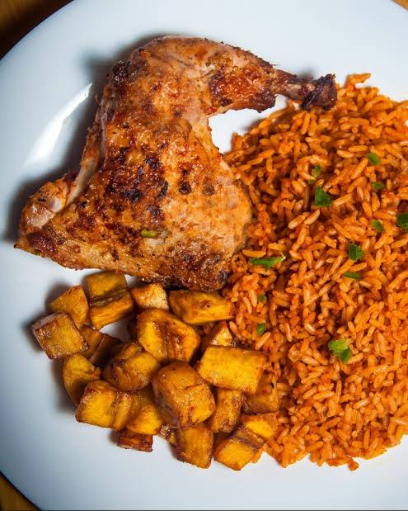
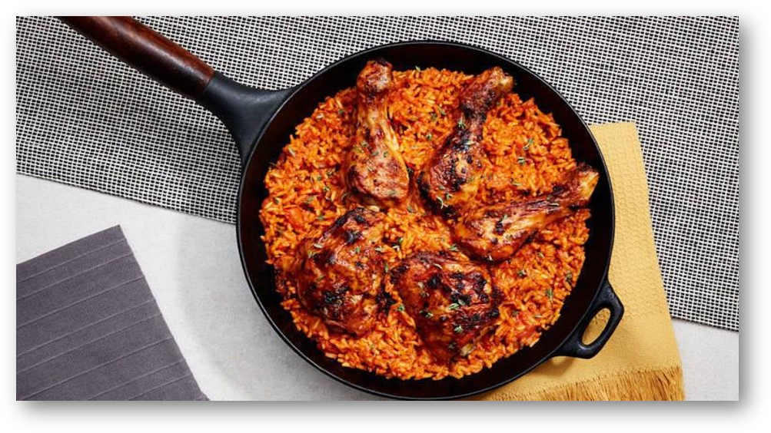
My favorite Nigerian food is Jollof rice.

Slide 10
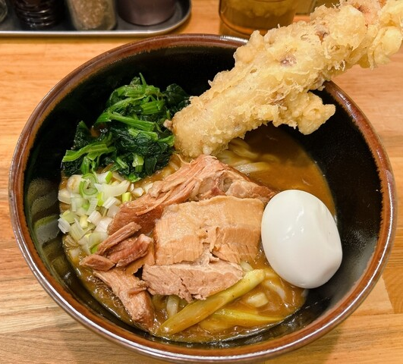
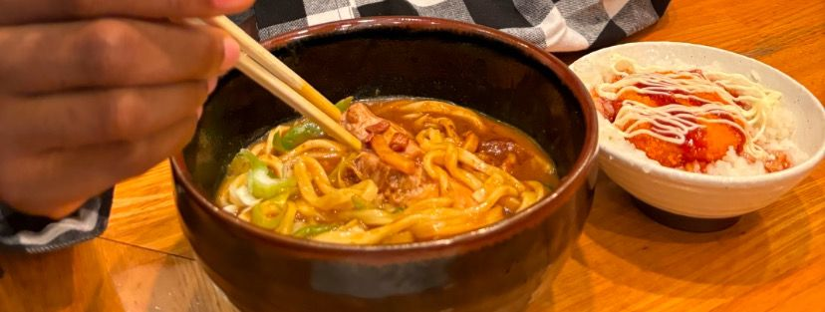
My favorite Japanese food is Curry Udon.

Slide 11
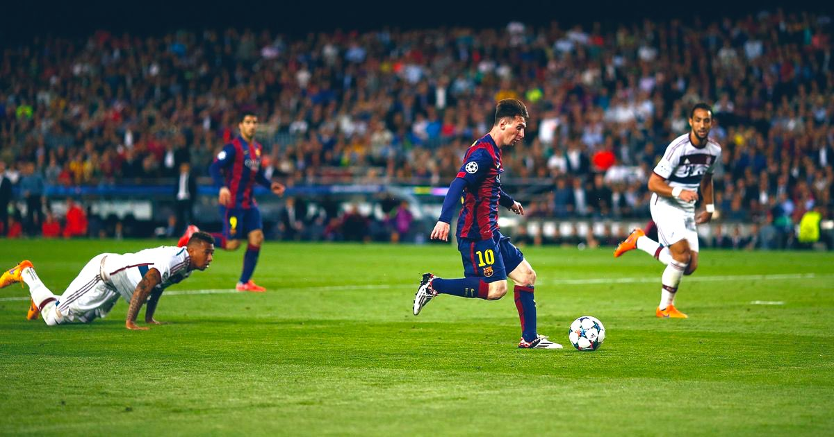
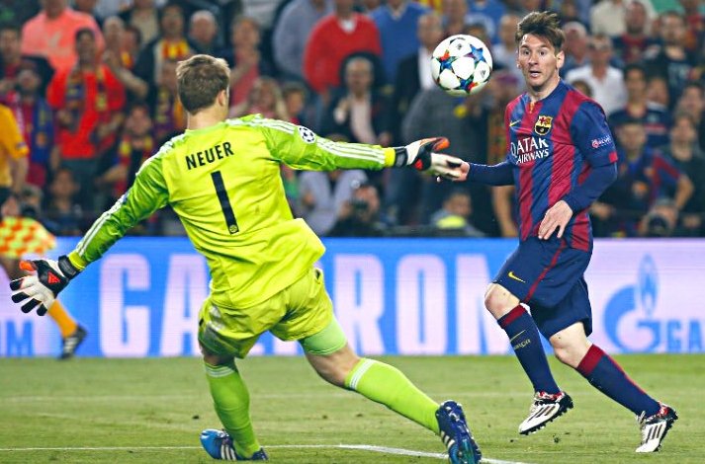
I like soccer.

Slide 12
My favorite color is Blue.

Slide 13
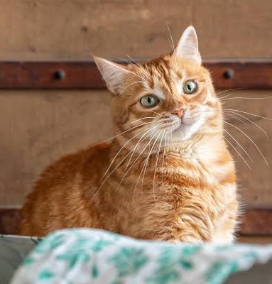
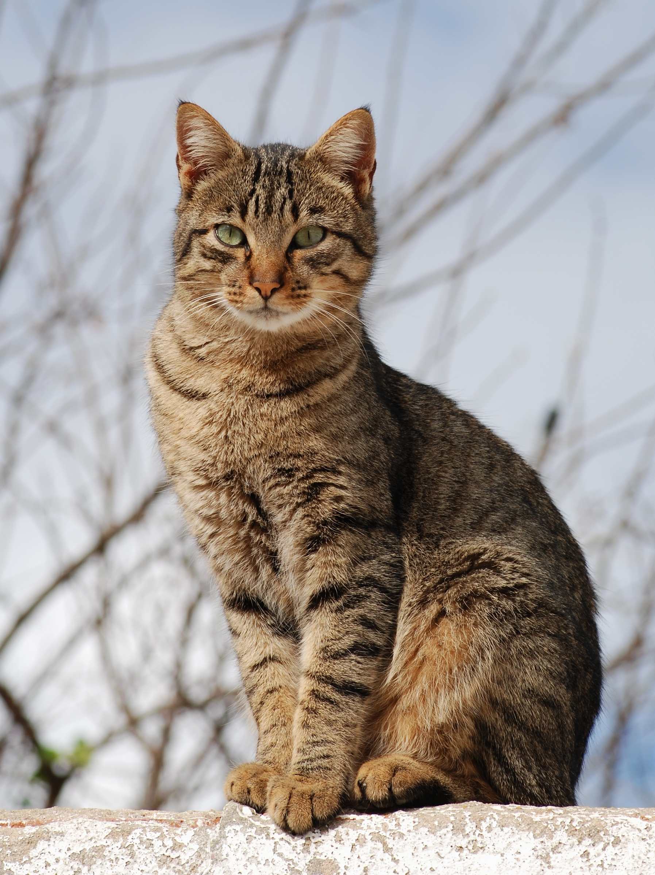
I like Cats.

Slide 14

My favorite subjects are English and Science.

Slide 15


I like listening to music and playing games.

Slide 16
Thank you for listening.
Let’s have fun studying English!

Slide 17

Questions

Slide 18
1. What is my favorite color?
2. What animal do I like?

Slide 19
3. What country am I from?
4. What is my favorite Japanese food?

Slide 20


5. When is my birthday?
6. What is my favorite season?

Slide 21
7. What sport do I like?
8. What is my favorite Nigerian food?

Slide 22
9. What subject do I like?
10.What anime do I like?

Slide 23
Thank you!

